Slide 1
Applying Blockchain to Energy Delivery Systems
Anthony Cosimo, Dakota Moore, Katie Ringgenberg, Keegan Bloedel, Steven Rein, and Jacob Dawson

Slide 2
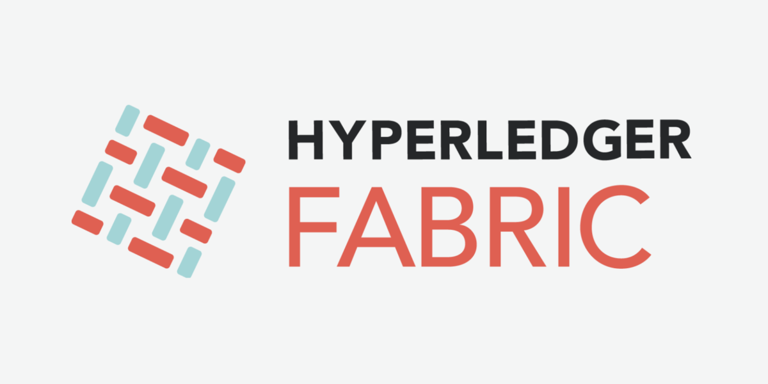
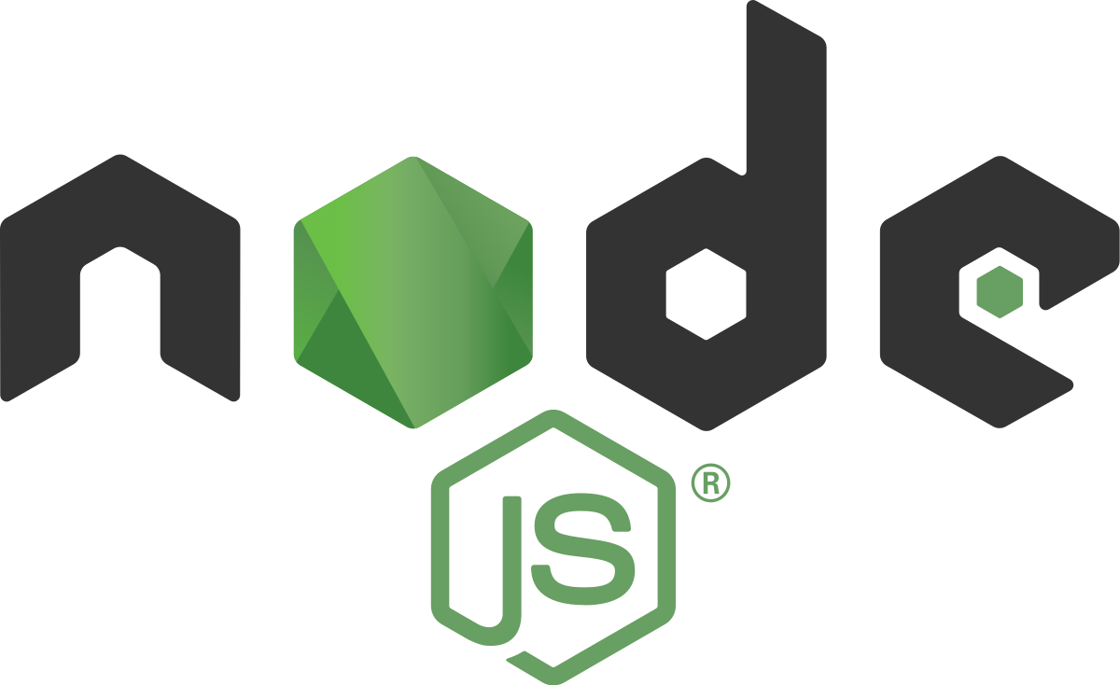
Integration of Blockchain with API
Selecting identity from wallet
Connecting to network gateway
Accessing network
Constructing request
Submitting transaction
Processing response
All works locally, but will it be just easy after deploying?

Slide 3
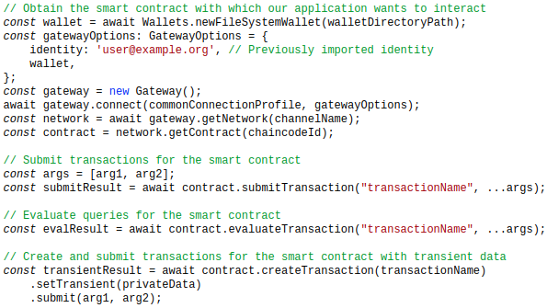
Technical Challenges We Have Faced
Initial integration between API and Blockchain Network
Solution: Hyperledger Fabric Node SDK
Hyperledger Composer is deprecated
Composer is a collaboration tool for building blockchain business networks

Slide 4
Technical Challenges We Expect
Deploying blockchain network to virtual machines.
Configuring networking between the virtual machines.
Piping test data from virtual devices provided by PowerCyber into the blockchain network.
Ideal: Execute smart contracts from PowerCyber devices
Not ideal: Having the API act as a middle man to execute smart contracts

