Slide 1
Applying Blockchain to Energy Delivery Systems
Project Plan
Team: sdmay20-12
Client: Grant Johnson
Adviser: Manimaran Govindarasu
Team Members
Anthony Cosimo - Test Engineer
Jacob Dawson - Report Manager
Keegan Bloedel - Meeting Facilitator
Katherine Ringgenberg - Meeting Scribe
Steven Rein - Software Architect
Dakota Moore - Cybersecurity Manager

Slide 2
Introductory
Problem Statement:
Energy Delivery Systems are deployed in an environment that is geographically distributed utilizing public internet infrastructure for communications. The integrity of measurements, commands, and authenticity of control devices performing communication are critical for trusted operations.
Use Cases

Slide 3
Introductory
Technical Tasks
Gather requirements
Gain domain knowledge
Implement a functional five node Blockchain Network
Implement the Smart Contract Layer
Implement the API
Implement the UI
Integrate with PowerCyber Devices
Implement system-level testing
Expected End Products/Deliverables
A fully functional blockchain node system
Authenticate calls from API to the Blockchain Network
Web-based user interface
Project documentation
Continuous integration and deployment infrastructure
Notes:
Gather requirements -> gather functional and non-functional requirements

Slide 4
Assumptions and Limitations
Assumptions
Server hardware and operating system environment will be made available through PowerCyber and these resources will be sufficient for the development.
We will be provided access to devices that use PowerCyber.
Limitations
There is no budget for the project, thus, we are constrained to using PowerCyber resources.
If the PowerCyber resources are found to be insufficient, the sponsor will either arrange for different resources or modify the scope to work with the existing resources.
Hyperledger Fabric must be used as the permission-based distributed ledger framework.
All Hyperledger Fabric related code must be written in JavaScript.

Slide 5
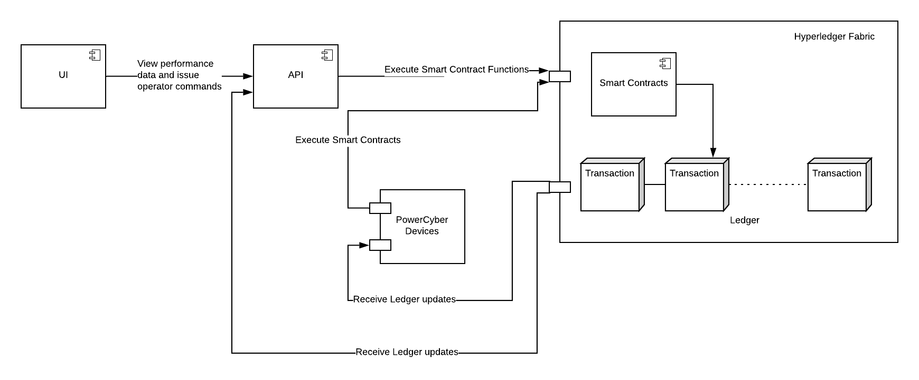
Proposed Approach and Statement of Work
Objective: Develop a blockchain energy delivery system that adds security and reliability.
Assessment of Proposed Design
Notes:
Advantages:
Remove dependencies on a central service
Hyperledger-fabric - permissioned blockchain system, prevent 51-percent attack
All interactions must be authenticated and proven to be true by more than one source

Slide 6
Timeline Walkthrough
Tasks | Sept 3rd - Oct 14th | Oct 15th - Oct 28th | Oct 29th - Nov 11th | Nov 12th - Dec 9th | Dec 10th - Jan 6th | Jan 7th - Jan 27th | Jan 28th - Feb 24th | Feb 25th - Mar 23rd
Requirements Gathering
Gaining Domain Knowledge
Prototyping
Blockchain Network
Smart Contract Layer
Implement the API
Implement the UI
PowerCyber Integration
System-level testing

