Slide 1
Applying Blockchain to Energy Delivery Systems
Narrated By: Dakota
CPRE/SE/EE 492 Spring 2020
Team: sdmay20-12
Website: sdmay20-12.sd.ece.iastate.edu
Faculty Advisor: Professor Manimaran Govindarasu
Client: Grant Johnson, Cyber Security Research Manager for Ames Laboratory
Notes:
Hello and welcome to our presentation over Applying Blockchain to Energy Delivery Systems.
We are team sdmay20-12 and my name is Dakota Moore. To learn more about our team, please visit our website.
The faculty advisor assigned to our team is professor Manimaran from Iowa State University.
The client that proposed the project is Grant Johnson from the Ames Laboratory
Next Slide Please

Slide 2
Concerns With Energy Delivery Systems:
Current Systems Have Flaws:
Uses public internet infrastructure
Single point of failure
They’re susceptible to attacks
Our Client Hypothesizes Blockchain Can Strengthen Systems:
Allows creation of a private & permissioned network
Blockchains are hosted over several nodes
Our client wants research on how to develop a blockchain & it’s performance
It could be wrong or possibly add more problems than it solves.
Narrated By: Dakota
Sdmay20-12: Project Plan
Notes:
When we look at current energy delivery systems. we can see some Flaws, such as how:
Energy Delivery Systems use public internet infrastructure for communication instead of some private network.
Control centers with some number of distributed stations under their control are a possible single points of failure, questioning the stability of each branch of the system.
Being publicly facing, it makes the system as a whole more vulnerable to attacks. This puts data integrity at risk or can cause an interruption of functionality,
Our client proposed the hypothesis that blockchain could strengthen current systems by addressing some of these issues.
It strengthens current systems by allowing us to host these systems on a private, permissioned network.
The system would be hosted over several nodes that are usually geographically separated to add stability in the case of a node failure.
Blockchain could help, or it could be entirely the wrong approach.
While blockchain gives developers the tools to make a secure and stable network, it’s performance is ultimately dependent on how it’s configured and implemented, it doesn’t automatically promise security nor stability.
We could come to the solution that Blockchain could be too slow or unstable to use live data for input.
Blockchain could be too complicated to implement into existing systems or lack required functionality to operate in these systems.
Next Slide Please

Slide 3
What’s Wrong & How We Plan To Address It
Problem Statement:
Energy Delivery Systems are deployed in an environment that is geographically distributed utilizing public internet infrastructure for communications. The integrity of measurements, commands, and authenticity of control devices performing communication are critical for trusted operations.
Proposed Solution:
Develop a secure network for a geographically diverse Energy Delivery System by using blockchain to develop this network to make it more reliable and secure.
Narrated By: Dakota
Sdmay20-12: Project Plan
Notes:
After going through requirements gathering with our client, we did some initial research and came up with the following problem statement and proposed solution.
Problem Statement:
Energy Delivery Systems are deployed in an environment that is geographically distributed utilizing public internet infrastructure for communications. The integrity of measurements, commands, and authenticity of control devices performing communication are critical for trusted operations.
Problem Solution:
Develop a secure network for a geographically diverse Energy Delivery System by using blockchain to develop this network, making it more reliable and secure.
Next Slide Please

Slide 4
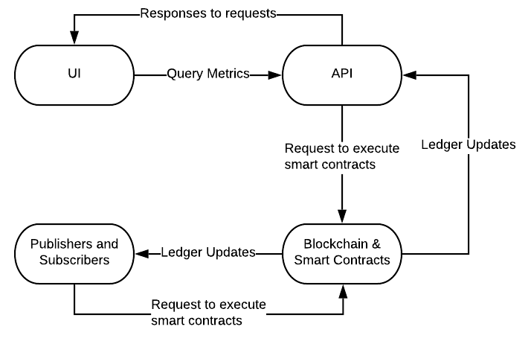
Our Solution:
Our plan is to develop 4 modules:
UI: Uses API to interact with blockchain via smart contracts
API: Allows UI to interact with blockchain via smart contracts
Blockchain: Multiple, separate nodes, each containing a ledger, make up the blockchain. Smart Contracts allow authorized devices (&API) interact with the BC
Publishers: Decodes and Posts data from authorized devices to the BC when actively running
Narrated By: Dakota
Sdmay20-12: Project Plan
Notes:
We plan on using a modular architecture for this project. We did this so that each part of the network would be able to function independently of the others for stability reasons.
Our solution can be broken down into just 4 modules:
The UI:
which Allows an authorized user to retrieve metrics, register a blockchain user, and/or to start the publishers by sending requests to the API and displaying the results.
Next: the API:
The API Accepts query/user registration requests from the UI.
It selects the appropriate certificate & formats a request to execute a smart contract with the blockchain, using the request data given by the UI.
The API Hands off the returned values (or error) to the UI as well as Maintains a wallet, storing registered users’ certificates.
Which leads us to the main module, the Blockchain and Smart Contracts:
The blockchain consists of multiple nodes, with each containing a copy of the ledger. The ledger stores all of the data on the blockchain.
Smart Contracts allow authorized devices and API to interact with the data contained within the Blockchains ledger and are accepted or rejected by multiple endorsing nodes using raft consensus for authenticity.
After executing a smart contract, the ledger stores a copy of the interaction and every node in the system updates its ledger.
Publishers:
Publishers are used to Decode and Post data, such as readouts from instruments on the network, from authorized devices to the BC by use of smart contracts.
Next, I’m going to let Keegan discuss the functional requirements of each module.

Slide 5
Functional Requirements:
UI | API | Blockchain (BC) & Smart Contract (SC) | Publishers & Subscribers
Used via web browser Works independently Users can: Make requests Display returned data Issue commands to Publishers to start/stop publishing data | Requires authentication for use Uses BC Nodes to authenticate Allows use of Smart Contract functions | Has ≥5 organizations Uses raft consensus Has multiple nodes as orderers Supports read, update, delete, & query data functions Stores records on the ledger Defines 2+ endorsing nodes for consensus | 3 Publishers running, each publishing to 1 BC organization Publishers sends BC the data decoded from some PCAP file. Publisher sends newly published record IDs to Subscriber Upon receiving new record ID, Subscriber queries the BC using the new ID
Narrated By: Keegan
Sdmay20-12: Project Plan
Notes:
UI
The User Interface shall be rendered in a modern web browser.
The UI should be able to work independently, that is, given the API is down the User Interface shall remain functional.
A user shall be able to make request to query.
A user shall be able to start and stop the data from publishing to the blockchain
API
The API shall expose the Smart Contract functions to Web Requests from the User Interface
The API calls shall be authenticated to the Blockchain Node System.
When the Blockchain network is down the API shall return an appropriate error code indicating the loss of the Blockchain Network.
BC
The Blockchain Network shall consist of at least five organizations with two nodes each for transaction consensus.
The Blockchain Network shall consist of multiple nodes to act as orderers.
The Blockchain Network shall use Raft consensus for the ordering service and the deterministic consensus algorithm.
SC
The Smart Contracts shall implement the blockchain function to query data stored on the blockchain.
Users that are assigned to a channel are the only users allowed to utilize the Smart Contracts functions made available to that channel.
Each Smart Contract shall define more than one endorsing node for consensus.
Publishers & subscribers
Three Publishers shall run, each publishing to a single blockchain organization.
The Publishers shall send synchrophasor data to the blockchain. The synchrophasor data should be retrieved from a PCAP file.
The Publishers shall have the ability to be stopped and started from the User Interface.

Slide 6
Constraints & Considerations
Constraints:
No budget
Must use JavaScript, blockchain, & Hyperledger Fabric
Hardware hosting the network has storage limitations
Considerations:
Original software choice for framework was depreciated
Software choices must work with an API
Working with live data, possibly operated on in real time
Narrated By: Anthony
Sdmay20-12: Project Plan
Notes:
As far as constraints go, we luckily didn’t have too many.
Because the team wasn’t given a budget, we had to use resources given to us by PowerCyber.
We also had to work in Javascript as it’s the language that our client wanted us to use.
This choice worked out well though as it’s a language that allowed the various components of the system to integrate well with the blockchain network.
Along with utilizing blockchain technology, we specifically must use Hyperledger Fabric as the distributed ledger framework.
Another constraint we had were our given resources. You could consider the set memory and storage space of the virtual machines to be technical constraints.
When designing our prototype, the team had a few considerations to keep in mind.
Initially, our choice of framework for building a blockchain was deprecated.
When choosing an alternative, we needed to make sure it would work with the API.
We also had to keep in mind that ultimately our blockchain network would be operated in real time and use live, continuous data.
Next slide please

Slide 7
Possible Risks | Mitigation Action
Blockchain’s possibly wrong for a solution. | Work with client & PowerCyber to determine if there’s some use case for implementing blockchain.
Lack of domain knowledge could lead to simple mistakes. | Visit PowerCyber, interview domain experts, asking questions to the client and advisor when necessary.
Integration could fail | Automate integration, maintain documentation and acceptance tests.
Narrated By: Keegan
Sdmay20-12: Project Plan
Notes:
Blockchain being the wrong solution
This risk is valid because the time to complete consensus among the peers in the blockchain may take too long for the desired use cases.
We plan to avoid this risk by profiling the deployed blockchain system to determine fitting use cases.
Lack of domain knowledge
The architecture of the project, classes, data-flow, and test assertions could be invalid due to our lack of domain knowledge.
We plan to mitigate this risk by gaining domain knowledge by visiting PowerCyber, interviewing PowerCyber researchers, and asking questions to the client and advisor when necessary.
Integration of System Components could fail.
The integration between the Smart Contract Layer and the API could fail and the integration between Publishers, Subscribers and the Blockchain Network could fail.
We plan to mitigate this risk by integrating early and integrating often. Also, we plan to maintain js documentation throughout each component.

Slide 8
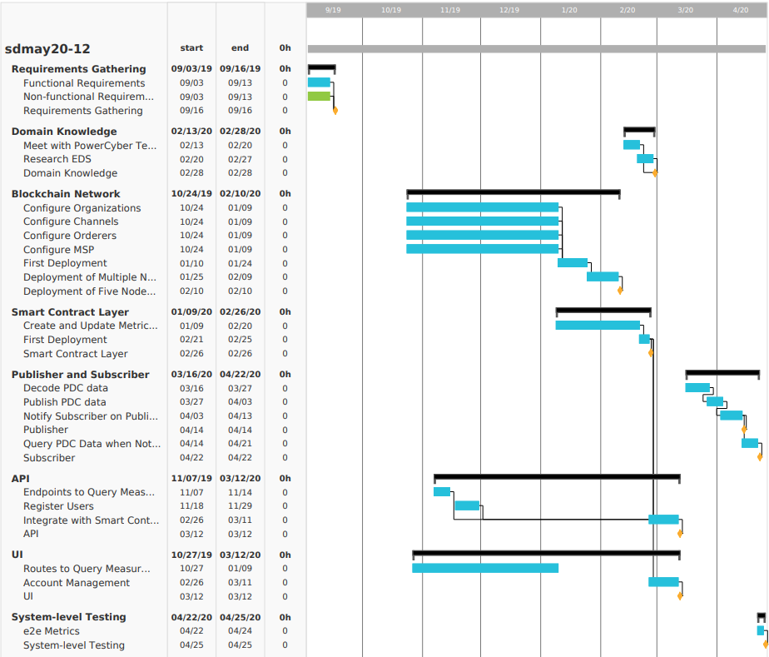
Project Schedule:
Milestones:
Gather all requirements
Understanding of the domain
Configuring an example BC
Initial Deployment of BC
BC works with API & devices
BC has 5+ orgs
API initial build
API exposes S.C functions
UI displays in web browser
UI works with API to use S.C.
UI displays correct data
Integrate BC into given system
Successful end-to-end test
Narrated By: Keegan
Sdmay20-12: Project Plan
Notes:
Here is the Gantt chart for our project. We have our gantt chart broken down into components, Requirements gathering, domain knowledge, blockchain network, smart contract layer, publisher and subscriber, API, UI and system level testing. Our three biggest components, the UI, API and Blockchain we worked on in parallel as shown in the gantt Chart. You can see these three components took the most time based off of the black bars associated with them indicating how long we worked on them. The one thing that changed in our project schedule was the addition of publishers and subscribers. We originally did not have this component in our project schedule. We added in this component to be able to test our blockchain latency and performance.

Slide 9
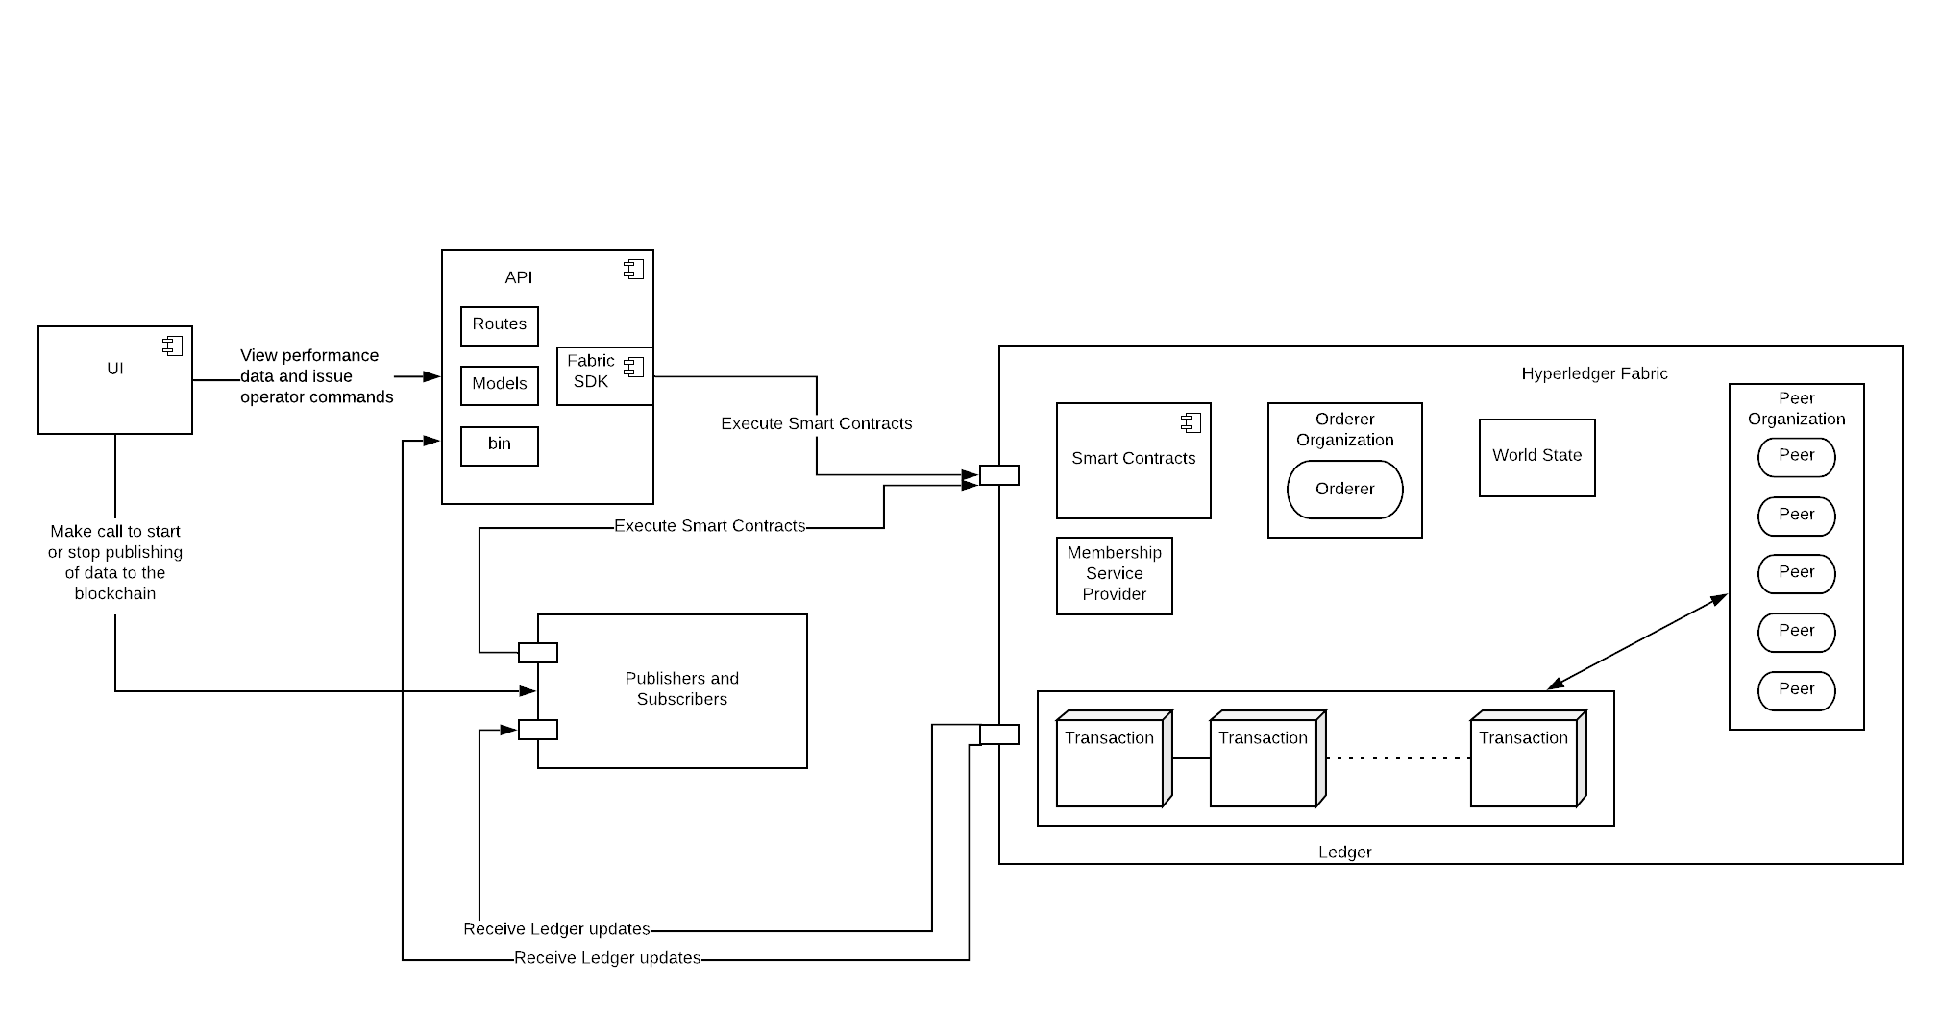
A Functional Decomposition
Narrated By: Keegan
Sdmay20-12: Project Design
Notes:
UI:
Is able to make calls to the API to have it execute the smart contracts for querying
is able to make calls to the publishers to start and stop the publishing of data to the blockchain
API
Queries blockchain by executing the smart contracts
The wallet is also stored on the API which is used to authenticate requests to the smart contracts
Blockchain
Chaincode is installed on each peer that allows publishers and subscribers to create and query data respective to their organization’s permissions.
Publishers and Subscribers
Publishers decode data found in a PCAP file and then publish that decoded data for a specified time
The subscribers query the data that is on the blockchain network. This allowed us to test the latency of publishing as well as up-down latency

Slide 10
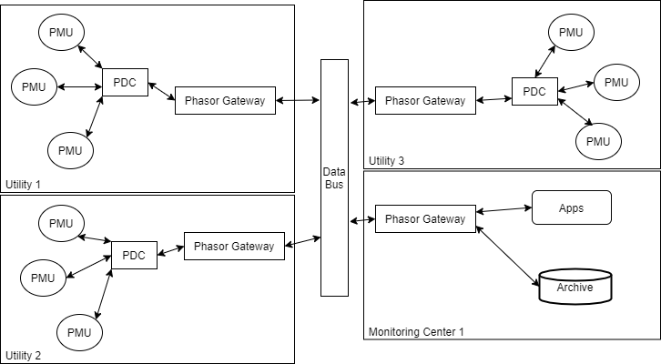
Detailed Design: Blockchain
NASPInet:
A standard for the infrastructure of synchrophasor communication networks.
Narrated By: Steven
Sdmay20-12: Project Design
Notes:
“Good afternoon, my name is Steven Rein and I am going to talk a bit about the blockchain network and our design”
“So we chose to model our system after NASPInet. NASPInet is a conceptual infrastructure model for synchrophasor communication networks. As you can see on the diagram, there are three utilities and one monitoring center shown here. The entities labeled PMU in the diagram represent devices that publish synchrophasor data. The entities labeled PDC gather that data and combine the measurements for PMUs. Finally the data can be published to the Data Bus, then other organizations such as other Utilities or Monitoring centers can use the data they have access to. ”
***Next Slide Please***

Slide 11
Detailed Design: Blockchain
We used HyperLedger Fabric for a permissioned distributed framework containing:
Organizations: groups interacting in the system.
Peers: hosts ledger & chaincode. The ledger holds our database. The chaincode, or Smart Contract, is a modular set of code (contract) executed for reading/writing from/to the Ledger.
Certificate Authority Servers: primary authentication method for users/external systems to interact with the blockchain network. Uses certificates for authenticating users.
Orderers: used for validating Ledger updates by peers.
Ordering Service: formed from all orderers together, validates a transaction submitted by a peer using raft consensus.
Publisher: a tool for publishing synchrophasor data to the blockchain.
Narrated By: Steven
Sdmay20-12: Project Design
Notes:
“For our blockchain network, we are using HyperLedger Fabric, which is a permissioned blockchain framework. The organizations in hyperledger fabric represent groups interacting in the system. The peers in the blockchain network host the ledger and the chaincode. The ledger contains the database for storing transactions. The chaincode, or smart contract, is a set of code that can be used for executing operations on the Ledger, such a reading or writing data. The Certificate Authority Server is the authentication method for users and external systems to interact with the blockchain. The orderers are used for validating ledger changes that are made by the peers and the chaincode. The Ordering Service is made up of all orderers in the network. Finally, the publisher is a tool that we developed for publishing synchrophasor data to the blockchain network.”
***Next Slide Please***

Slide 12
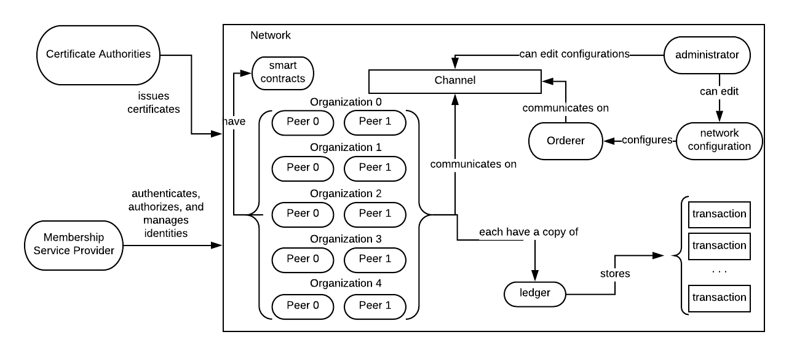
Detailed Design: Blockchain
Narrated By: Steven
Sdmay20-12: Project Design
Notes:
“Here you can see a diagram of our network, we have 5 organizations, each with two peers. We have 5 certificate authority servers, and 5 orderers. Each peer has a smart contract and a copy of the ledger containing transaction data. The peers and the orderers both communicate on a channel. Peers can use multiple channels for communication, but our project only uses one. The ledger will organize and separate data by which channel it is accessed on.”
***Next Slide Please***

Slide 13
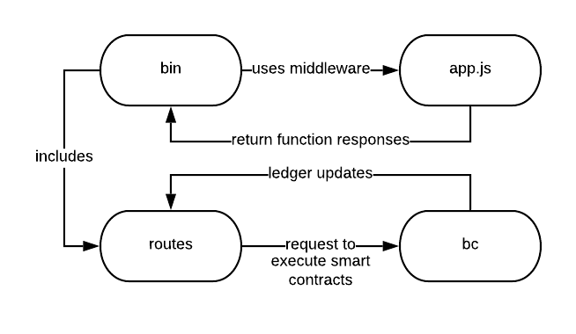
Detailed Design: API
A RESTful web service utilizing Node.js, Express.js, and sdmay-fabric-wrapper.
Accepts query/user registration requests from UI.
API selects appropriate certificate & formats a request to execute a smart contract
Hands off returned value to UI
Maintains a wallet, storing registered users’ certificates.
Narrated By: Jacob
Sdmay20-12: Project Design
Notes:
Hello, I’m Jacob Dawson.
Our API is a RESTful web service that utilizes Node.js and our own npm package, sdmay-fabric-wrapper, that we created to make it easier to execute smart contracts for applications that install this package. The API uses this package when it accepts query requests from the UI and when a request is made to register a user with the blockchain network. When a user is registered with the blockchain network, their certificate is stored in a wallet that is maintained in the API. This certificate is used when a registered user makes a request to execute smart contracts.
Now Katie will go into the detailed design of the UI.

Slide 14
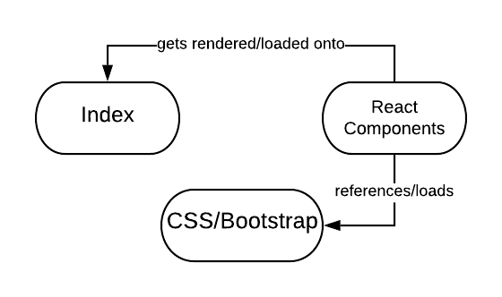
Detailed Design: UI
The UI is composed of two main sections:
The Dashboard contains:
A station status board
A line graph showing stations’ frequency deviations as well as one showing blockchain publisher frequencies
A metric outlier list
An area displaying phasor data for the stations.
The Blockchain Command Center
Allows user to retrieve metrics, register a blockchain user, and/or to start the publishers.
Narrated By: Katie
Sdmay20-12: Project Design
Notes:
The UI has three main purposes: act as a monitoring utility for the blockchain, show various statistics, and display recent data that is stored on the blockchain.
To accomplish these tasks, the UI is separated into two main components – the dashboard and the blockchain command center.
The dashboard contains several items.
There’s a station status board, which shows the statuses of the different stations that are transmitting data.
There are a couple graphs showing blockchain and metric statistics.
Outlier metrics can also be viewed in the dashboard.
Lastly, the dashboard is also responsible for displaying the most recently retrieved data metrics.
The blockchain command center allows the user to interact more directly with the blockchain.
From the blockchain command center, the user can retrieve a singular or range of metrics stored in the blockchain.
The user can also start and stop our blockchain publishers as well as register blockchain users.
Next slide please 😊

Slide 15
Operating Environment
API, UI, and blockchain run on linux-based virtual machines
Hardware Used:
Provided Servers
Phasor Data Concentrator Publishing Data
Personal & provided work PCs
Software Used:
JavaScript
CouchDB
React.JS
Node.JS
Hyperledger Fabric
Ubuntu Server
Narrated By: Katie
Sdmay20-12: Project Design
Notes:
For our operating environment, all components – the UI, API, and blockchain – run on linux-based virtual machines, specifically Ubuntu, provided by PowerCyber.
The servers that the virtual machines were hosted on as well as our personal computers were the main hardware aspects of this project.
For softwares used, the list is a little more lengthy. They include JavaScript, CouchDB, ReactJS, Hyperledger Fabric, NodeJS, and our Ubuntu VMs.
Next slide please 😊

Slide 16
Testing Process
Functional Testing:
Unit Testing: All individual tasks had 1+ tests for each component.
Integration Testing: We tested a deployed blockchain network to ensure correctness when integrating each module.
Tested if blockchain can accurately execute smart contracts & update all nodes.
The API & UI tested separately by running commands through the UI or API and comparing the results against known data.
System Testing: We did end-to-end tests, including a test to ensure user has access the UI, can query data with the UI, using the API to execute said query on the blockchain, then comparing results with the expected results.
Narrated By: Anthony
Sdmay20-12: Project Testing
Notes:
The Testing process for our project consists of two main parts, functional and non-functional.
Starting with, Functional testing. Our Functional testing can be broken down into three main parts. Unit Testing, Integration Testing, and System Testing.
For Unit Testing, if a Task involved configuring or creating a part of the blockchain, smart contact, API, or UI then each part of the task was given a Unit test to ensure correctness.
Next we have integration testing, for this we deployed a blockchain network to ensure the integration of each module.
Then we tested that the blockchain could correctly execute smart contracts, and update each peer.
The API and blockchain integration was tested by running commands to query on known data.
Lastly, for system testing we did end-to-end tests, including a test to ensure users have access to the UI, can query data with the UI, and can use the API to execute queries on the blockchain.
Then we compared these results with the expected results.
Next slide please

Slide 17
Testing Process Continued
Non-functional Testing
API: Unit tests for query response times for each endpoint.
Blockchain: It’s difficult.
Used HyperLedger Fabric CLI to test basic queries & establishing a connection with the network.
We tested latency and throughput as well to get the correct configuration.
Smart Contract Layer: Used an eslint rule to ensure that there is JSDoc for all controllers, models, functions, classes, etc.
UI: Automated acceptance tests in place that simulate loss of communication between the UI and API, and loss between blockchain and API.
Narrated By: Anthony
Sdmay20-12: Project Testing
Notes:
On to non-functional testing.
*slight pause*
Non-functional testing was done on the API, blockchain, Smart contract layer, and the UI.
Non functional testing of the API consisted of using unit tests to test query response time for each endpoint.
Non functional testing of the blockchain is not an easy thing to do as it mainly consists of configuration files.
In order to do this testing we installed and and instantiated the blockchain, then used Hyperledger Fabric Command Line Interface
to run queries on the test data in the chaincode. This was done to ensure a connection was established.
Also, to ensure correct configuration we tested latency and throughput as well.
For the smart contract layer, we used an eslint rule to ensure that there is a JSDoc for all controllers, models, functions, and classes.
Lastly for the UI we used automated acceptance tests to simulate a loss of connection between the UI and the API. We did this simulated loss for the API and blockchain as well.
Next slide please

Slide 18
Project Demonstration
Narrated By: Katie
Sdmay20-12: Project Demo
Notes:
Now we’re going to go over some demos of our project.
Next slide please 😊

Slide 19
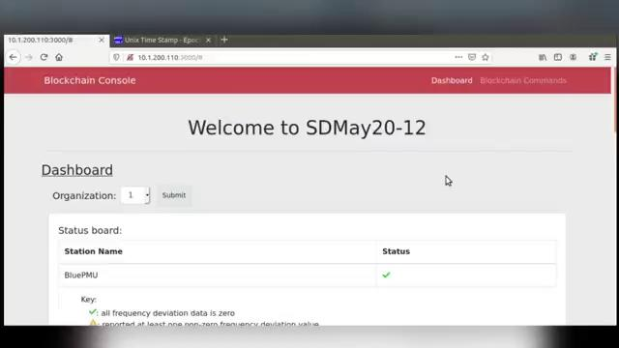
Narrated By: Katie
Sdmay20-12: Project Demo
Notes:
When the user interface is accessed, the first thing you see is the dashboard.
The user can select which blockchain organization data they’d like to view.
Here they can also see the status board for the different stations. Currently there’s only one, and we can see that it’s actively transmitting data because of the green check mark.
If we scroll down a little, we can see two graphs. The one on the left is the station frequency deviation line graph. We expect all values to be zero.On the right, we have the blockchain publisher frequency graph which displays the frequency at which the blockchain published data over the last five minutes.
And if we scroll down a little more, if there were any outlier data values, they would be listed here in this outlier card.
And then below that, we show the most recent phasor data retrieved.
We’ll scroll back up and select the blockchain command center.
This is where we can retrieve either a singular or a range or metrics.
Blockchain users can also be registered here, and our blockchain publishers can be managed here as well.
Next slide please 😊

Slide 20
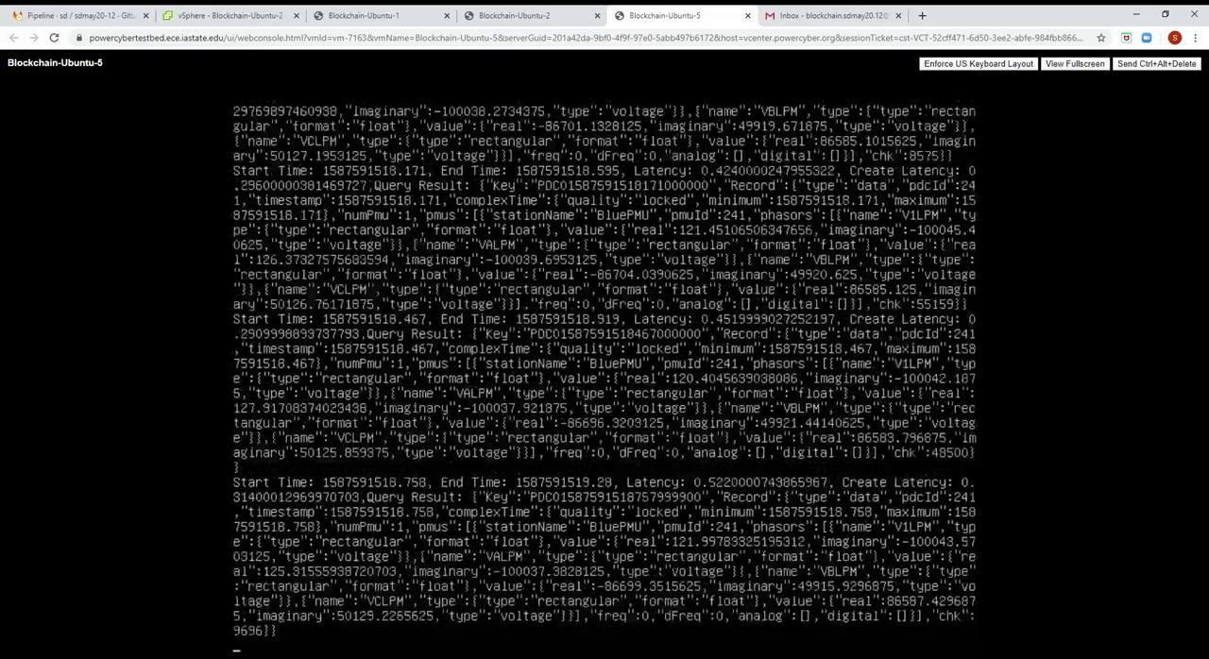
Notes:
“Here we have a demo of the tool we call the Pub-Sub Performance Testing Tool. The tool publishes to the blockchain network, after the publishing is completed the publisher will notify the subscriber that there is new data available, if the subscriber can then successfully query the data from the blockchain network, the transaction is a success, and the latency results will be added to a CSV file for later analysis.”
***Talk over the demo until I am writing JSON, then discuss the arguments***

Slide 21
What We Learned
Initially handling recording 0.4metrics/second
Adjusting blockchain network configuration landed us a final rate of 3m/s
The goal: record 60m/s on 3 different organizations, concurrently.
We modified chaincode & system publishing to the network to send 1 request/second, each request containing 60 metrics.
Narrated By: Steven
Sdmay20-12: Project Testing
Notes:
“The Pub-Sub Performance Testing Tool enabled us to discover some important information about our blockchain configuration and publishing strategy. Initially the blockchain was able to handle recording 0.4 metrics per second. After adjusting the configuration of the blockchain network the blockchain was recording 3 metrics per second.
Our goal was to be able to concurrently record 60 metrics per second on three different organizations. To increase the capabilities of the network, we modified the chaincode and the system publishing to the network to send 1 request per second, with each request containing 60 metrics. This performance testing allowed us to drastically increase the performance of our network.”

Slide 22
Engineering Standards and Design Practices
Agile Software Development
Test-driven Development
Continuous Integration & Deployment
Peer Reviews
NASPInet Standard
IEEE-C37.118-2005
Narrated By: Jacob
Sdmay20-12: Standards & Practices
Notes:
Our team used some agile software development values.
We used 2 week sprints, maintained a sprint board, monthly retros, and had weekly standups
Another agile value we used was Test Driven Development
When pairing, TDD was often used when implementing new features
Also, each MR required tests to accommodate new implementation. This encouraged the use of TDD
We also used CI & CD
Each component has tests that run when new code is checked in
and each component’s deployment is automated when checked into master
Peer Reviews
Each MR must be approved by a peer and must pass all tests before merging into master
NASPInet
Our Blockchain network resembles that of the NASPInet conceptual infrastructure model for synchrophasor communication networks. The NASPInet standard is an effort to develop a standardized infrastructure to support synchrophasor applications.
IEEE-C37118-2005
When we implemented the Publisher component, we needed to use the IEEE-C37118-2005 standard in order to properly decode PMU data.

Slide 23
Task Responsibilities
Anthony Cosimo - (Test Engineer):
Worked on API, testing for UI, and Publisher. Also worked on PCAP data decoding.
Jacob Dawson - (Project Manager):
Allocated issues to team, worked on API, wrapper, decoding and publishing PCAP data.
Keegan Bloedel - (API Architect):
Worked on API, wrapper, and decoding PCAP data that we are getting from PowerCyber
Katherine Ringgenberg - (UI Architect):
Designing, implementing, and testing the user interface
Steven Rein - (Blockchain Architect):
Implemented blockchain network & chaincode. Worked on decoding PCAP data & minor API changes.
Dakota Moore - (Cybersecurity Manager):
Worked on BC research, security aspects/implementations, and developed most of the class deliverables.
Narrated By: Jacob
Sdmay20-12: Conclusion

Slide 24
Moving Forward
Real time data aggregation mechanisms
Linking in real time data sources
Experimentation with consensus settings
Targeted cyber security testing
Performance of Cloud hosting vs. current solution
Blockchain publishing performance with multiple subscribers
Narrated By: Jacob
Sdmay20-12: Conclusion
Notes:
Moving forward we could link our system with devices at PowerCyber labs instead of publishing simulated data from a PCAP file
We could reconfigure the consensus settings for smart contract execution to possibly increase performance
We could also target cyber security testing by running simulations of malicious data being entered and seeing how we could detect that
Could also compare the performance of the blockchain network when deployed to a cloud hosting service instead of the servers at PowerCyber
And lastly, we could examine the performance when there are multiple subscribers making query requests upon the creation of new records

Slide 25
Project Q&A
Sdmay20-12: Project Q&A

