Slide 1
Applying Blockchain to
Energy Delivery Systems
Client: Grant Johnson
Adviser: Manimaran Govindarasu
Team: sdmay20-12
Website: sdmay20-12.sd.ece.iastate.edu
Anthony Cosimo - Test Engineer
Jacob Dawson - Project Manager
Keegan Bloedel - API Architect
Katherine Ringgenberg - UI Architect
Steven Rein - Blockchain Architect
Dakota Moore - Cybersecurity Manager

Slide 2
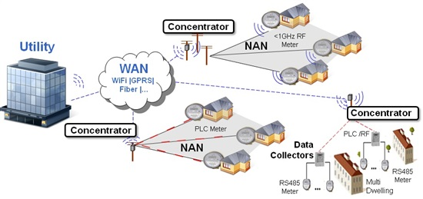
Our Vision
Power grids are getting more complex while still relying on public internet infrastructure for communications, making it more vulnerable to attacks. Implementing Block chain can fix this!
Source: https://e2e.ti.com/blogs_/archives/b/toolsinsider/archive/2014/06/05/the-power-of-information-onthegrid
sdmay20-12: Applying Blockchain to Energy Delivery Systems
Notes:
Problem: grid is getting more complex and communicating on public internet infrastructure which makes it more susceptible to attacks.
BC Attributes: opportunities to help solve this problem:
Immutable record of data,
Authenticity of communicating devices,
Provenance/History of data and communications
User Impact - communicated as protecting against attacks that create outages --- wide area outages for people's homes, outages for manufacturing facilities (economic impact), outages to human services (hospitals, grocery stores, etc). You can look up the Russia attack on Ukraine as a point of reference that created a multi-hour outage for something like 250K citizens.

Slide 3
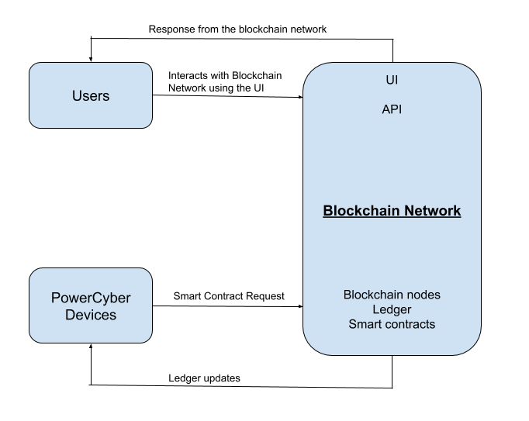
Conceptual Diagram
sdmay20-12: Applying Blockchain to Energy Delivery Systems
Notes:
what is being designed? -
We are designing a blockchain that is accessed through an API using a UI.
Who is the targeted clientele? -
Everyone. More stable and secure energy delivery systems benefit anyone who is connected to the power grid, meaning just about everyone.
What is unique about the approach? -
Typical EDS are deployed using public internet infrastructure. By using BC we have created a network that is more secure and is no longer housed on a single device, adding more stability.

Slide 4
Functional Requirements
Blockchain:
Consist of at least five nodes for transaction consensus
Consist of multiple nodes to act as orderers
User Interface:
Ability to request/view measurements and/or metrics if the user has the authority to do so
Smart Contract Layer & API:
API: expose the Smart Contract functions upon authentication
Smart Contracts: read, update, delete, and query data
Operational Environment:
Blockchain network, UI, and API: run on a linux-based virtual machine provided by PowerCyber
sdmay20-12: Applying Blockchain to Energy Delivery Systems

Slide 5
Non-Functional Requirements
API and Blockchain: have swagger documentation
Blockchain network nodes: be ran using Docker containers
Smart Contracts: update blockchain network
Include a descriptive project wiki
CI/CD: can run all tests and deploy to the necessary environments
sdmay20-12: Applying Blockchain to Energy Delivery Systems

Slide 6
Constraints
No budget - constrained to using PowerCyber resources.
Hyperledger Fabric must be used as the permission-based distributed ledger framework per client’s request.
Hyperledger Fabric related code must be written in JavaScript
sdmay20-12: Applying Blockchain to Energy Delivery Systems

Slide 7
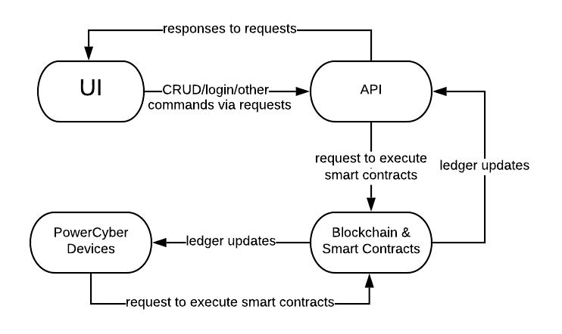
Conceptual Design Diagram
Level 0 Diagram
sdmay20-12: Applying Blockchain to Energy Delivery Systems

Slide 8
Project Tasks
Requirements Gathering
Domain Knowledge
Blockchain Network
Smart Contract Layer
API
UI
PowerCyber Device Integration
System-level Testing
sdmay20-12: Applying Blockchain to Energy Delivery Systems
Notes:
Requirements Gathering
Functional and Non-functional Requirements
Domain Knowledge
Meeting with PowerCyber Team
Research Energy Delivery Systems
Blockchain Network
Configuring specific components of the blockchain
Organizations, channels, orderers, Membership Service Providers
Smart Contract Layer
CRUD Metrics Data and Operator Commands
API
Endpoints for logging in, querying metrics data and command history, and creating commands
Integration with Smart Contract Layer
UI
Routes for querying metrics and device-specific commands, issuing device-specific commands, and account management
PowerCyber Device Integration
System-level Testing
e2e metrics and operator commands

Slide 9
Risk and Mitigation
Title | Risk | Mitigation Action
Blockchain could possibly be the wrong solution. | Avoid | Profile Blockchain system to determine fitting use cases.
Team’s lack of domain knowledge could lead to easy to detect flaws being introduced into the system. | Mitigate | Gain domain knowledge by visiting PowerCyber, interviews, and consulting with client and advisor. Frequent feedback.
Potential security risks exposed by the UI. | Mitigate | Implement input security and disable file uploads.
A user’s login could be compromised. | Mitigate | Create and analyze user action log, two-factor authentication, and HTTPS.
Integration of system components could fail. | Mitigate | Integrate early and integrate often. Maintain Swagger documentation.
sdmay20-12: Applying Blockchain to Energy Delivery Systems
Notes:
Blockchain being the wrong solution
This risk is valid because the time to complete consensus among the nodes in the blockchain may take too long for the desired use cases.
We plan to avoid this risk by profiling the deployed blockchain system to determine fitting use cases.
Lack of domain knowledge
The architecture of the project, classes, data-flow, and test assertions could be invalid due to our lack of domain knowledge.
We plan to mitigate this risk by gaining domain knowledge by visiting PowerCyber, interviewing domain experts, and asking questions to the client and advisor when necessary.
UI could present security risks
If a malicious user could access the UI they could possible perform malicious acts such as a SQL injection or XSS attack, which could then give them access to protected data or inject malicious code into the project.
We plan to mitigate this risk by implementing checks for text input and implementing other security features to prevent other possible cyber attacks on the UI.
A user’s login could be compromised
When a user’s login is compromised private information and possibly controls to the PowerCyber devices can be compromised..
A log will be created that consists of actions from every user. This log will be analyzed to ensure that no abnormalities exist that show signs of unauthorized access. Two-factor authentication and HTTPS will also be implemented to help secure login information.
Integration of System Components could fail.
The integration between the Smart Contract Layer and the API could fail and the integration between PowerCyber Devices and the Blockchain Network could fail.
We plan to mitigate this risk by integrating early and integrating often. Also, we plan to maintain Swagger documentation for each endpoint in the API.

Slide 10
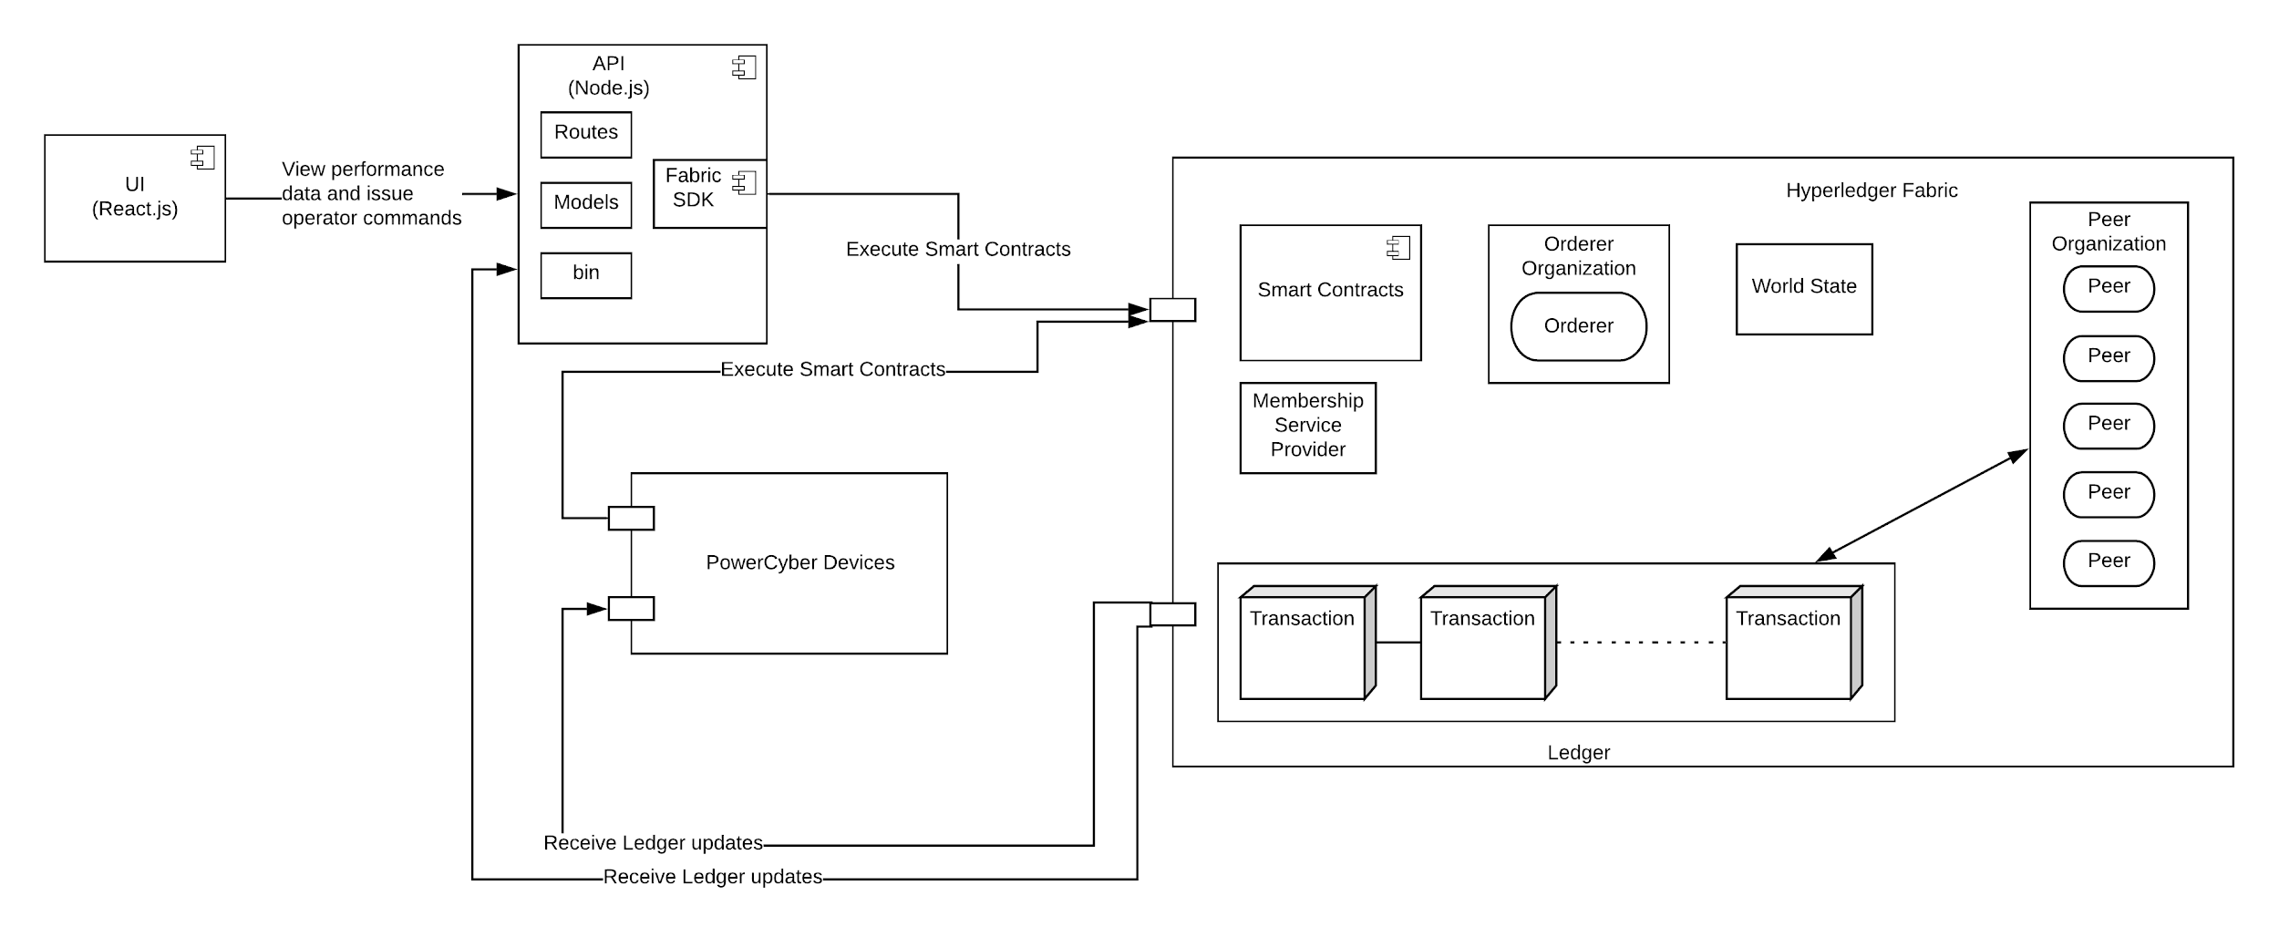
System Architecture
sdmay20-12: Applying Blockchain to Energy Delivery Systems

Slide 11
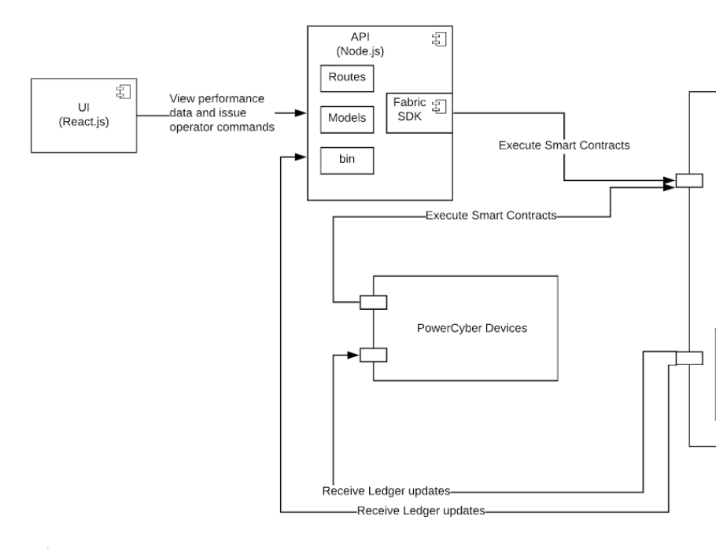
UI & API Architecture
React.js
Node.js
Fabric SDK
Smart Contracts
sdmay20-12: Applying Blockchain to Energy Delivery Systems

Slide 12
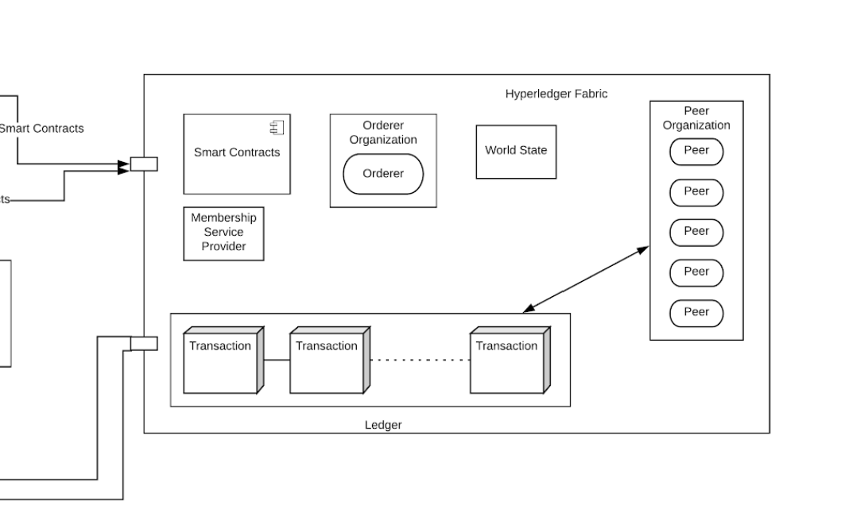
Blockchain Architecture
Hyperledger Fabric
Docker
Raft Consensus
CouchDB
sdmay20-12: Applying Blockchain to Energy Delivery Systems

Slide 13
Standards
1028-2008 - IEEE Standard for Software Reviews and Audits
26515-2018 - IEEE International Standard - Systems and software engineering -- Developing Information for Users in an Agile Environment
NERC CIP-011-2 - Cyber Security - Information Protection
sdmay20-12: Applying Blockchain to Energy Delivery Systems
Notes:
Information Protection -
the NIST Cybersecurity Framework ---- emit
peer reviews:1028 IEEE standard for software reviews
agile: 26515 :
need to add specific standards that will be followed
these standards are what the utilities need to be regulated against
we think that blockchain follows these standards
NERC CIP:
To prevent unauthorized access to Bulk electric system (BES) Cyber System information by specifying information protection requirements in support of portecting BES cyber systems against compormise that could lead to misoperation or instability in the BES.

Slide 14
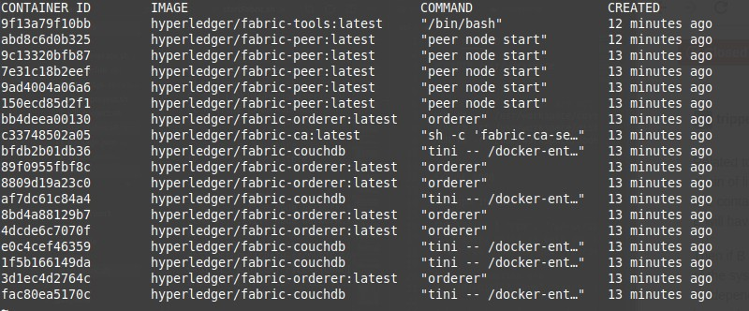
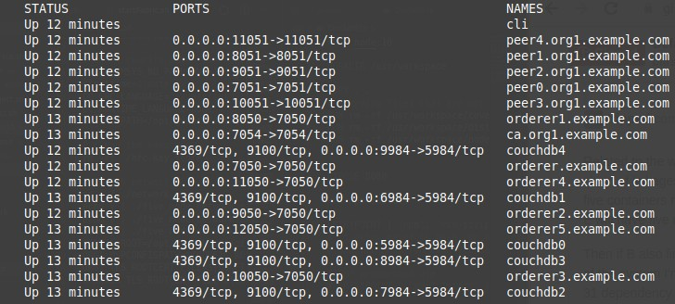
Prototype: Blockchain
sdmay20-12: Applying Blockchain to Energy Delivery Systems
Notes:
<Add Notes -Steven>
*As you can see from our prototype implementations, so far we have only been developing the project locally. The first step when we return next semester will be to deploy the prototypes onto the virtual machines provided to us.*

Slide 15
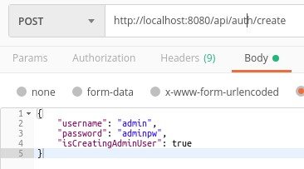
Prototype: API
sdmay20-12: Applying Blockchain to Energy Delivery Systems
Notes:
<Add Notes -Steven>
*As you can see from our prototype implementations, so far we have only been developing the project locally. The first step when we return next semester will be to deploy the prototypes onto the virtual machines provided to us.*

Slide 16
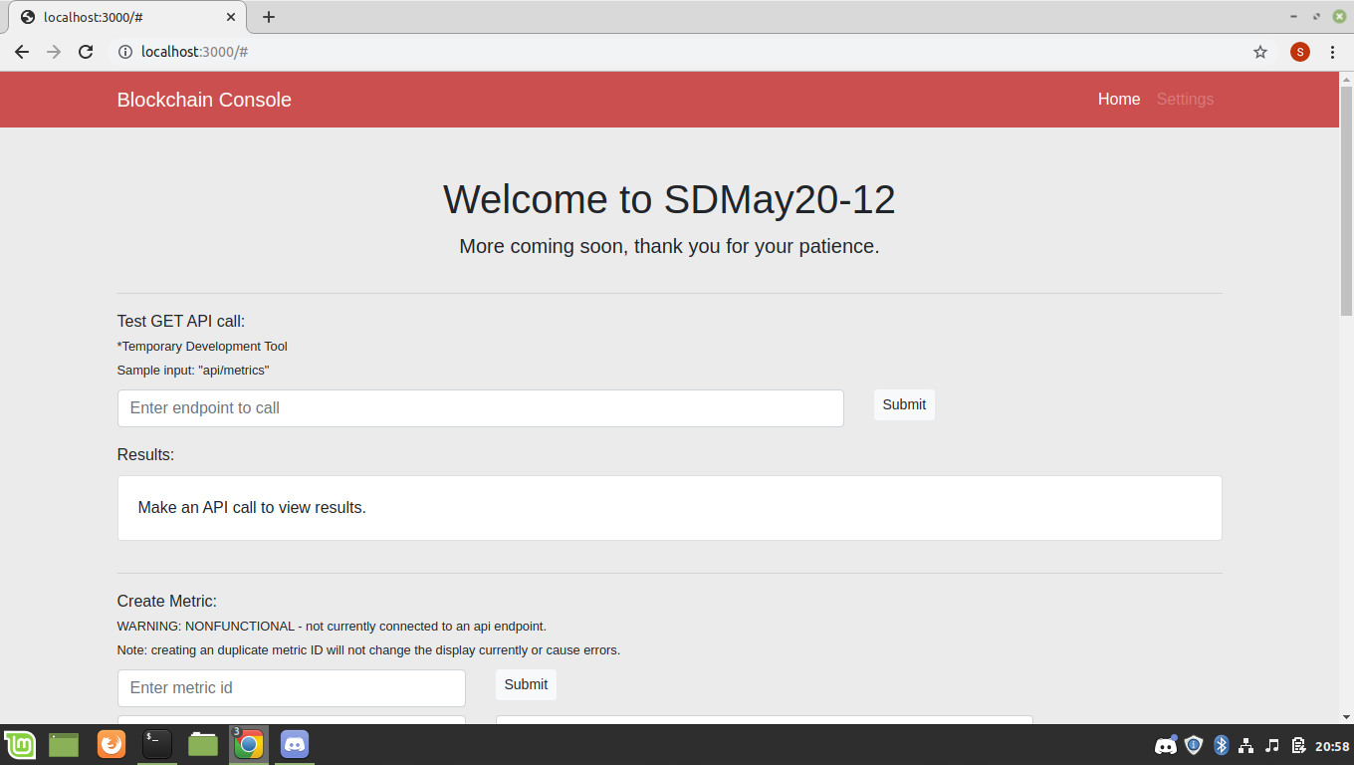
Prototype: UI
sdmay20-12: Applying Blockchain to Energy Delivery Systems
Notes:
<Add Notes -Steven>
*As you can see from our prototype implementations, so far we have only been developing the project locally. The first step when we return next semester will be to deploy the prototypes onto the virtual machines provided to us.*

Slide 17
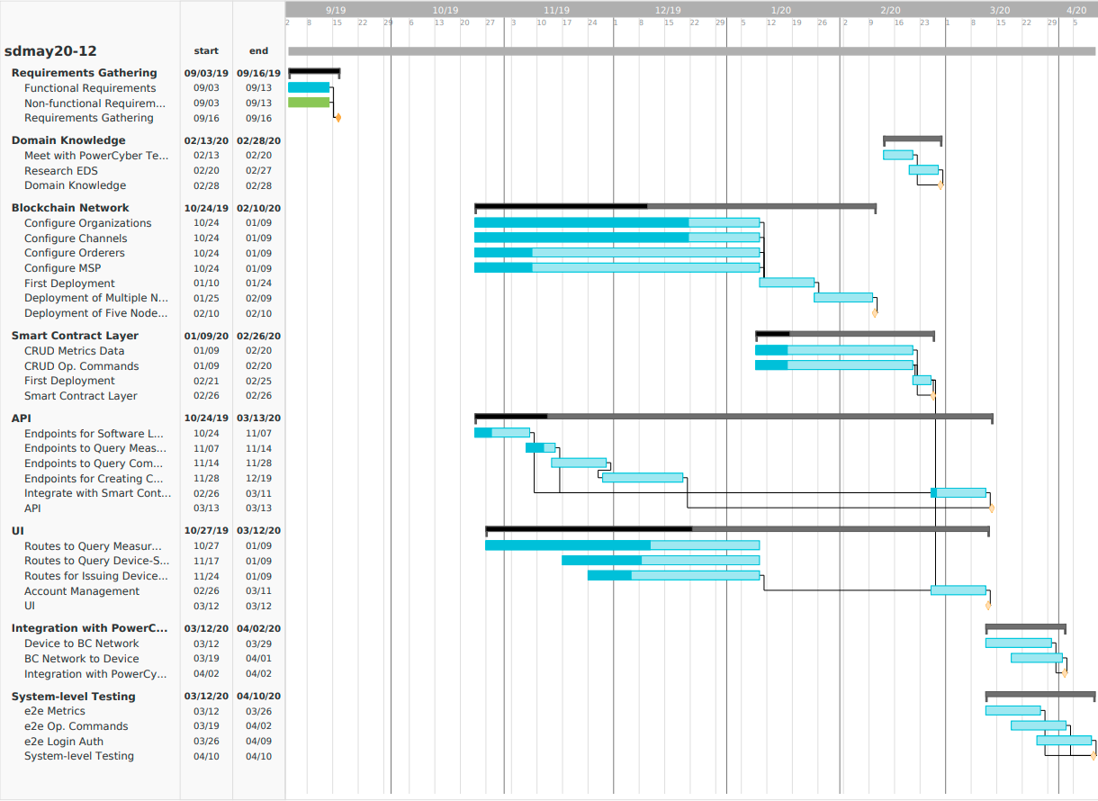
sdmay20-12: Applying Blockchain to Energy Delivery Systems
Notes:
Here is our Gantt Chart. We have the Gantt Chart broken down into components. Our plan is to update the Gantt chart at the end of every sprint next semester. More granular project tracking will be done using GitLab issues. If we find larger unforeseen issues as development proceeds we will update the Gantt chart accordingly.

Slide 18
Testing Hardware & Software
API
Use Jest to send automated HTTP requests to API
Smart Contract
Use Jest to assure ledger updates occur when executed
Blockchain Network
Use Hyperledger Fabric CLI to send basic queries to nodes to test connect to network
User Interface
Jest will allow us use the DOM to test React components
sdmay20-12: Applying Blockchain to Energy Delivery Systems

Slide 19
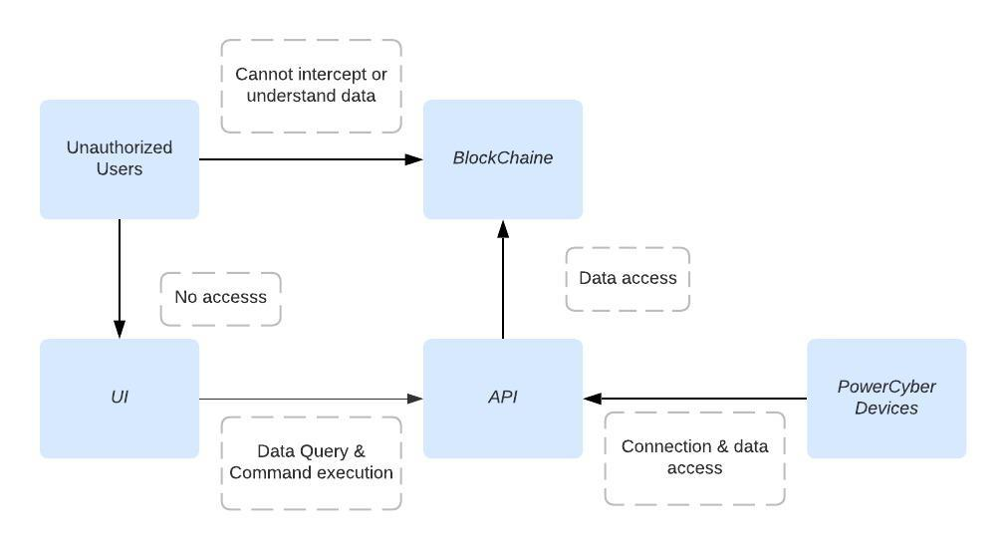
End to End Testing
sdmay20-12: Applying Blockchain to Energy Delivery Systems

Slide 20
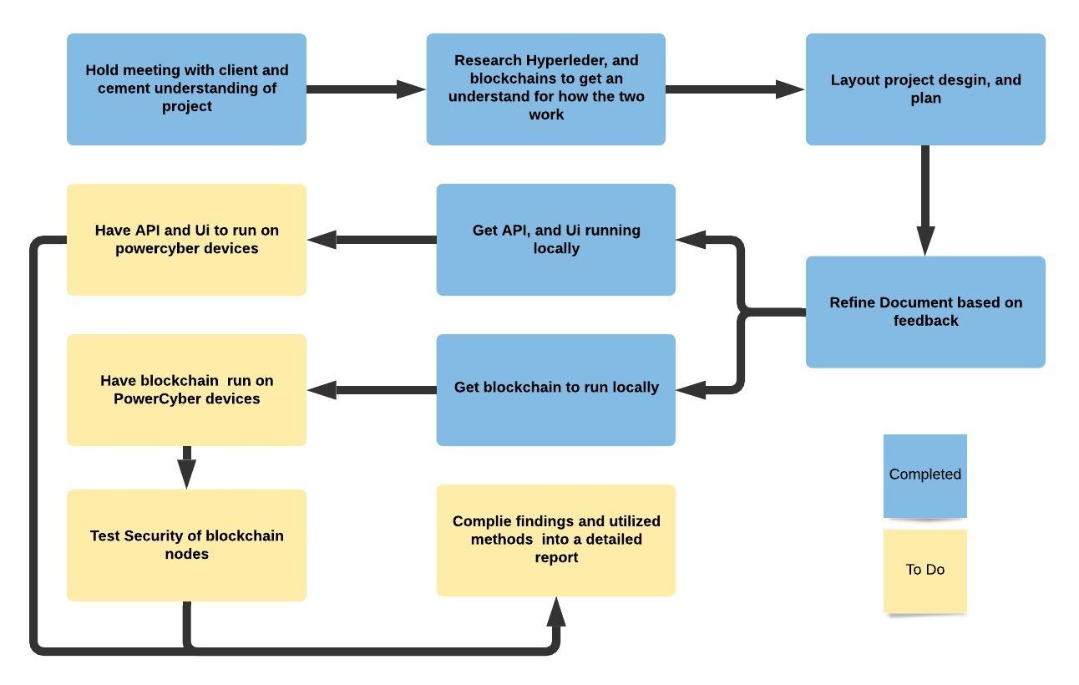
Overview
sdmay20-12: Applying Blockchain to Energy Delivery Systems

Slide 21
Appendices
sdmay20-12: Applying Blockchain to Energy Delivery Systems
Notes:
//Taken from previous presentation

Slide 22
Technologies
CouchDB: http://docs.couchdb.org/en/stable/
Express: https://expressjs.com/en/4x/api.html
HyperLedger Fabric: https://hyperledger-fabric.readthedocs.io/en/release-1.4/
HyperLedger Convector: https://docs.covalentx.com/article/71-getting-started
Moesif Orign &
CORS Changer: https://chrome.google.com/webstore/detail/moesif-orign-cors-changer/digfbfaphojjndkpccljibejjbppifbc
PowerCyber Labs: http://powercybersec.ece.iastate.edu/powercyber/welcome.php
Raft: https://raft.github.io/
React.JS: https://reactjs.org/docs/getting-started.html
sdmay20-12: Applying Blockchain to Energy Delivery Systems
Notes:
//Taken from previous presentation

